Slide 1
Unit 2: Probability
General concepts of probability,
Law of probability, Additive and multiplicative, conditional probability, Random variable and distribution-Binomial, Poisson, Normaldistributibution, bivariate distribution.(8hrs)

Slide 2
General concepts of probability
A chance factor can always be associated with occurrences of such events. Theory of probability deals with such events and associates numerical values to the occurrences of uncertain events.
Inferential statistics heavily depends up on theory of probability.
Estimation of parameters from a sample depends up on the generalization of theories related to probability.

Slide 3
Random experiment: If a trial or experiment, conducted repeatedly under similar condition, results in more than one outcomes, then such an experiment is referred to as a random experiment.
Results of random experiment cannot be predicted in advance with certainty. For example when a coin is tossed, it may result in a head or a tail. Tossing a coin is then random experiment.
Similarly, a blood sample may give a positive or negative result, examination of water sample may produce a good or bad result, monitoring of air pollution may be within or outside guideline values.
These examinations are examples of random experiments.

Slide 4
Event: When an experiment id preformed, the outcome or a combination of outcomes forms an event. Suppose a dice is rolled, then getting an odd number or even are events. Similarly, if a surgical operation is conducted, happening of a successful operation is an event.
Favorable cases or events: Outcomes which result in happening of stated event are the favorable cases. When a dice is thrown, the number of cases favorable to event getting and odd number 3. The favorable cases are 1,3 and 5. Events favorable to graduates or above graduates, masters and doctorate degree holders or above. Similarly, events favorable to a positive diagnosis of disease may be various symptoms, events favorable to air pollution exposures may be exposures to particulate air pollution , carbon monoxide, benzene, Sulfur dioxide, Nitrogen dioxide etc.
Equally Likely Cases: Two or more cases are said to be equally likely when we have no reason to believe that one case is more likely than other. When balanced coin is tossed, happening of head or tail are equally likely. But there are cases whose occurrences are usually not equally likely such as positive and negative results, polluted and unpolluted areas, infected and healthy animals, etc are usually not equally likely cases.

Slide 5
Mutually exclusive events: Events are mutually exclusive if they cannot occur simultaneously in a single trial. For example, when a coin is tossed, it can result in either head or tail and both events cannot occur simultaneously. In other words, events are said to be mutually exclusive one and only one event can take place at a time. Example mutually exclusive events are passing or failing an examination of a person may be male or female, a person may be exposed or unexposed to an air pollutant etc. Events may not be mutually exclusive. For instance suppose event A is defined as drawing a heart and B is defined as drawing a queen. Since there is a queen which is also a heart in a pack of 52 cards, Events a an B can occur at the same time. Thus events are not mutually exclusive.
Exhaustive events: All possible outcomes also called the sample space of a random experiment are exhaustive events. For example there are 6 exhaustive events in rolling a dice, 52 exhaustive events in drawing a card from pack , two exhaustive vents in a diagnostic test etc.
Dependent and independent events: Two events are said to be independent if occurrence or non-occurrence of one event doesnot affect occurrence or nonoccurence of other event or events. For example, when a fair coin is tossed the occurrence of a head in the second toss is not affected by whether a head or tail has resulted in the first toss.

Slide 6
Complementary events: The complementary events of an event A is that A does not occur. An A and its complement are mutually exclusive and exhaustive. The complement of an event A is denoted as A^{c} and
For instance , complementary event of occurrence of infested person is occurrence healthy person. Similarly, occurrence of polluted sample and unpolluted sample, pass and fail complementary events.

Slide 7
Defining probability
Probability of an event means chance or likelihood of the event to occur. Probability has been defined in several ways:
a) Classical definition b) Empirical or relative frequency definition c) Subjective definition
d) Axiomatic definition

Slide 8
Example 4.1 A card is drawn at random from a pack of 52 cards. We illustrate finding the probability of drawing a) an ace b) red colored card and d) an ace or king
Total number of mutually exclusive and exhaustive cases =N= 52
Number of favorable cases in drawing an ace= m= 4
The probability of drawing an ace P(A)= m/n= 4/52 = 1/13
b) Number of favorable cases in drawing a red colored card= m =26
The probability of drawing a red card, P (A)= m/n= 26/52=1/2
c) Number of favorable cases in drawing a diamond = m =13
The probability of drawing a diamond card, P (A)= m/n= 13/52=1/4
d) Number of favorable cases in drawing an ace or king =m= 4+4=8
The probability of drawing an ace or king card, P (A)= m/n= 8/52=2/13

Slide 9
Example 4.2 In a country, department of environment ministry released a policy in view of reducing environmental pollution.
Opinion | Rural ( R ) | Urban (U)
Strongly support | 90 | 100
Mildly support | 110 | 30
Undecided | 20 | 20
Mildly oppose | 40 | 80
strongly oppose | 40 | 70
Total | 300 | 300
Using the data calculate probability
a) Probability that a person living in the rural area is undecided about the policy is
P (a person living in rural area is undecided)= 20/300= 1/15
b) Probability that a person living in the rural area is strongly support about the policy is
P (a person living in urban area is undecided)= 20/300= 1/15

Slide 10
4.3 Consider the following frequency distribution of cocaine use by gender among adult cocaine users
Lifetime frequency of cocaine use | Male | Female | Total
1- 19 times category A | 32 | 7 | 39
20- 99 imes category B | 18 | 20 | 38
100+ times category C | 25 | 9 | 34
Total | 75 | 36 | 111
P of total cocaine user of category A= 39/111
P of Male cocaine users = 75/111
P of Cocaine use category B = 38/111
P of Male cocaine users B= 18/111
P of Cocaine use category C= 34/111
P of Male cocaine users C= 25/111

Slide 11
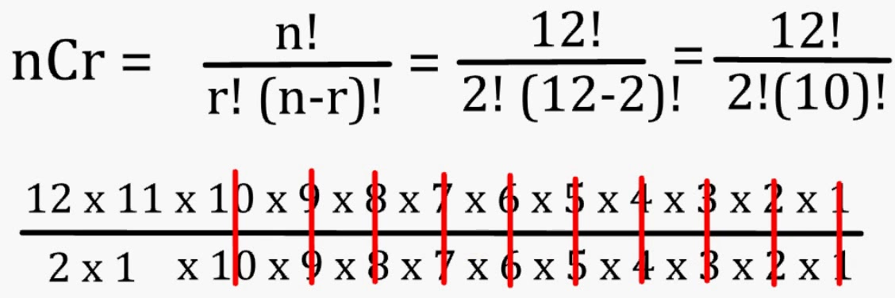
4.4 A group of 5 animals is selected from 5 males and 4 females. We wish to find the probability that 3 males and 2 females are selected.
The number of ways in which 3 males can be selected from 5 males is ⁵C₃=5*4*3*2*1/(3*2*(5-3))=120/12=10
The number of ways in which 2 females can be selected from 4 females is ⁴C₂=(4*3*2)/(2*(4-2))=6
The number of ways in which 3 males and 2 females can be selected is ⁵C₃ *⁴C₂ =10*6=60
The number of 5 animals can be selected from 9 animals = ⁹C₅=126
The required probability= 60/126=10/21

Slide 12
4.5 Two dice are thrown simultaneously. The sample space of possible occurrence is given by
1,1 | 1,2 | 1,3 | 1,4 | 1,5 | 1,6
2,1 | 2,2 | 2,3 | 2,4 | 2,5 | 2,6
3,1 | 3,2 | 3,3 | 3,4 | 3,5 | 3,6
4,1 | 4,2 | 4,3 | 4,4 | 4,5 | 4,6
5,1 | 5,2 | 5,3 | 5,4 | 5,5 | 5,6
6,1 | 6,2 | 6,3 | 6,4 | 6,5 | 6,6
To find the probability of getting a total of at least 9 we list the number of favorable cases as (3,6), (6,3), (4,5), (5,4), (4,6), (6,4), (5,5), (5,6), (6,5) and (6, 6) which are 10 cases in all
Total number of possible cases= 36, the required probability is 10/36= 5/18
For the event ‘an even total’, we may list 18 favorable cases. Thus the probability of getting an even total is 18/36= ½

Slide 13
Example 4.6 A child and an adult are undergoing the same treatment. After the treatment, the probability that the child recovers is 0.4 and probability that the adult recover o.7 . We wish to find the probability that at least one of them will recover.
Let P(A) = probability that the child recover and P(B) = probability that the adult recover
Then P(both does not recover)= {1-P(A)}*{1-P(B)}
=0.6*0.3=0.18
P (Adult recovers but Child doesn’t recover)= 0.7*0.6=0.42
P (at least one of the two recover)= 1- both donot recover
1-0.18= 0.82

Slide 14
Law of probability: Additive and multiplicative probability
If A and B are two mutually exclusive events, the probability occurrences of event A or event B is the sum of their respective probabilities.
We write
P(A or B)= P(AUB)= P(A)+ P(B)
4.7 A dice is thrown. Let A be the event getting a 2 and B be the event getting a 6.
The probability of A, P(A)= 1/6 and the probability B, P(B)=1/6
Since in a single throw only one of two events can occur, the probability of getting either 2 or 6 =1/6+1/6=1/3

Slide 15
Example 4.8 Consider the following distribution of children in a sample of families.
Number of children | 0 | 1 | 2 | 3 | 4 | 5 | 6 or more
Probanilities of family | 0.05 | 0.1 | 0.3 | 0.25 | 0.15 | 0.1 | 0.05
The probability that a family chosen at random will have say 4 or more children can be calculated as follows. Let A = event of choosing a family with 4 children,
B= event of choosing a family with 5 children &
C= event of choosing a family with 6 or more children.
The probability P(A or B or C)= P(A)+P(B)+P(C)= 0.15+.1+.05=0.3

Slide 16
Additive rule for events that are not mutually exclusive :For two events which are not mutually exclusive, both events may occur together. Therefore, the rule of addition of probabilities must be modified. If events A and B are not mutually exclusive then the probability of happening of A or B
P(A or B)= P(A)+P(B)-P(AB)
P(AUB)= P(A)+P(B)- P(A∩B)

Slide 17
4.9 Let event A be the event of drawing a king and event B be that of drawing a heart. Now a king may be a heart as well. Therefore, events A and B are not mutually exclusive with each other.
The probability of getting either a king or heart is given
P(AUB)=P(A)+P(B)-P(A ∩B)= 4/52+13/52-1/52=16/52=4/13

Slide 18
4.10: Suppose the chance that a child becomes sick from an environmental exposure is 1/5.
Suppose, the chance of an adult becomes sick from the same exposure is 2/5. Let both child and adult be exposed. We are interested to calculate the probabilities that
a) both of them will be sick b) at least one of them will be sick
The probability of child becomes sick= P(A)=1/5
The probability adult becomes sick = P(B)=2/5
The probability that both become sick =P(AB)=P(A)*P(B)=1/5*2/5=2/25 Probability of one of them will be sick =P(AUB)= P(A)+P(B)-P(A ∩ B)
=P(A)+P(B)-P(A)*P(B)
=1/5+2/5-(1/5)*(2/5)
=13/25

Slide 19
Conditional probability
In probability theory, conditional probability is a measure of the probability of an event occurring, given that another event has already occurred.
Conditional probability: p(A|B) is the probability of event A occurring, given that event B occurs. For example, given that you drew a red card, what's the probability that it's a four
So out of the 26 red cards (given a red card), there are two fours so 2/26=1/13.

Slide 20
Random variables
A random variable is a variable whose value is unknown or a function that assigns values to each of an experiment's outcomes.
A random variable can be either discrete (having specific values) or continuous (any value in a continuous range)
A random variable that may assume only a finite number or an infinite sequence of values is said to be discrete; one that may assume any value in some interval on the real number line is said to be continuous.
Two types of random variables are: Discrete and continuous

Slide 21
Distribution-Binomial, Poisson, Normal

Slide 22
Binomial distribution
Binomial distribution is an example of discrete probability distribution arises from experiment known as Bernolli process. The process can be described as below
Each trial has only 2 outcomes such as head or tail, male or female polluted or not polluted infected or non infected
Probability of an outcome of any trial remains fixed over the trials
Trials are statistically independent

Slide 23
A dice is rolled thrice. The probability of getting even number is ½. Let X be a random variable denoting the numbers. Then the probability of getting an even number twice is given by
P(X=2)=( ³₂)0.5²*0.5³⁻²=3*0.50²*0.5³⁻²=0.375
5.11 A Suppose 80% households in a survey use biomass fuel for cooking. A random sample
5 households is selected. Let X denote the number of households in the sample that use
biomass fuel. The probability of 2 households being biomass fuel users is
P(X=2)=[⁵₂]0.8²*0.2⁵⁻²=0.1*0.64*0.008*=0.0512
Similarly, the probability of 1 household being biomass fuel users is
P(X=1)= [⁵₁]0.8¹*0.2⁵⁻¹=0.1*0.8*0.0016*=0.0064
The probability of 0 household being biomass fuel users is
P(X=0)= [⁵₀]0.8⁰*0.2⁵⁻⁰=1*1*0.00032*=0.00032
The probability that at most 2 households being biomass fuel users is then
P(≤2)= P(X=0)+P(X=1)+P(X=2)
= 0.00032+ 0.0064+ 0.0512
=0.05792

Slide 24
The expected number of biomass fuel users households is
E(X)=np=5*0.8=4
Standard deviation of biomass fuel user households is σ=√npq= √5*0.8*0.2=0.894

Slide 25
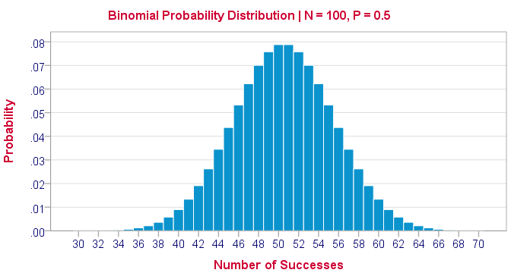
Binomial distribution
A frequency distribution of the possible number of successful outcomes in a given number of trials in each of which there is the same probability of success.
The binomial distribution is calculated by multiplying the probability of success raised to the power of the number of successes and the probability of failure raised to the power of the difference between the number of successes and number of trials. Then, multiply the product by the combination between the number of trials and the number of successes.

Slide 26
Properties of binomial distribution
Binomial distribution has 2 parameters namely n & p.
Mean is always greater than variance
Distribution is unless p=q=.5. If the distribution is positively skewed and if p>0.5 the distribution is negatively skewed
Under certain conditions, the distribution approaches poisson and normal distribution

Slide 27
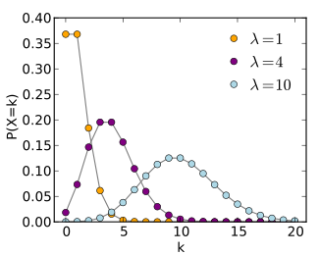
Poisson Distribution
The poisson distribution is a limiting case of binomial distribution when the number of trials is very large and the probability of success is very small such that λ =np is finite, λ being a positive number. A discrete random variable is said to follow Poisson distribution, if its probability mass function is given by
P(X=x)e λ/x! and e=2.71828

Slide 28
Example 1.13: Police record showed that on average 5 accidents have taken place in a certain street junction per month in the past. An investor wants to calculate the probability in any month of exactly 0,1, and 2 accidents. The poisson distribution can be used to calculate such probabilities.
P(X=0)=e⁻⁵5⁰/0! =0.0067
P(X=1)= e⁻⁵5¹/1! =0.0337
P(X=2)= e⁻⁵5²/2! =0.08425
P(X≤2)=0.0067+0.0337+0.08425=0.1247

Slide 29
Normal distribution
A continuous random variable is said to be normally distributted if its probability density function is given by
F(x)=1*e^{-1/2(x-µ)2}/σ√2π
Characteristics of Normal Curve:
It is a bell shaped symmetrical curve with a single peak
Mean, median and mode are all same
The 2 tails of the distribution extend indefintely and never touch the axis
Its skewness is zero and kurtosis is 3
The total area bounded by the curve above x-axis is 1.
Mean deviation from the distribution is 4/5 σ
It is unimodal

Slide 30
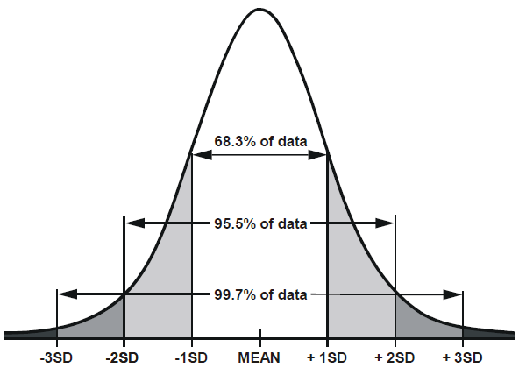
Area under the normal curve
Considering total area under normal curve as one unit, it is found that 68.27% of the total area is bounded by μ±σ. Similarly, 95.45 of the total area is bounded by μ±2σ and 99.73% of the total area is bounded by μ±3σ. The statements are true regardless of values of mean and variance

Slide 31
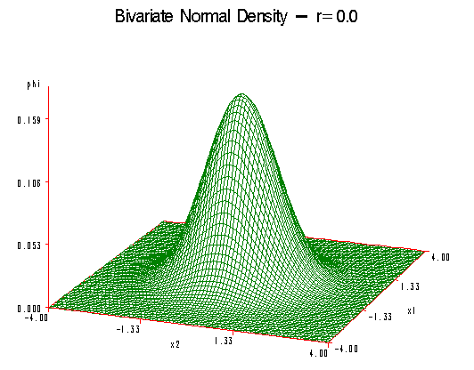
Bivariate distribution
A bivariate distribution, put simply, is the probability that a certain event will occur when there are two independent random variables in your scenario.
For example, having two bowls, each filled with two different types of candies, and pulling one candy from each bowl gives you two independent random variables, the two different candies.
Since you are pulling one candy from each bowl at the same time, you have a bivariate distribution when calculating your probability of ending up with particular kinds of candies.

Slide 32
Example 5.17 In an observation, 10% of the water samples had total hardness 60mg/l or more, 30% of the samples had total hardness 40 mg/l or less. From the information we sih to find mean and standard deviation assuming that the distribution of total hardness in water is normally distributed.
Let X be the total hardness of water given
P(X≤60)=0.1

Slide 33
THANKS TOO MUCH

